Slide 1






































































Greenbuds
Where Tech Meets Brand
Website Development & Digital Marketing Agency

Slide 2




Slide 3



Slide 4



Slide 5



Slide 6



Slide 7



Slide 8



Slide 9



Slide 10



Slide 11

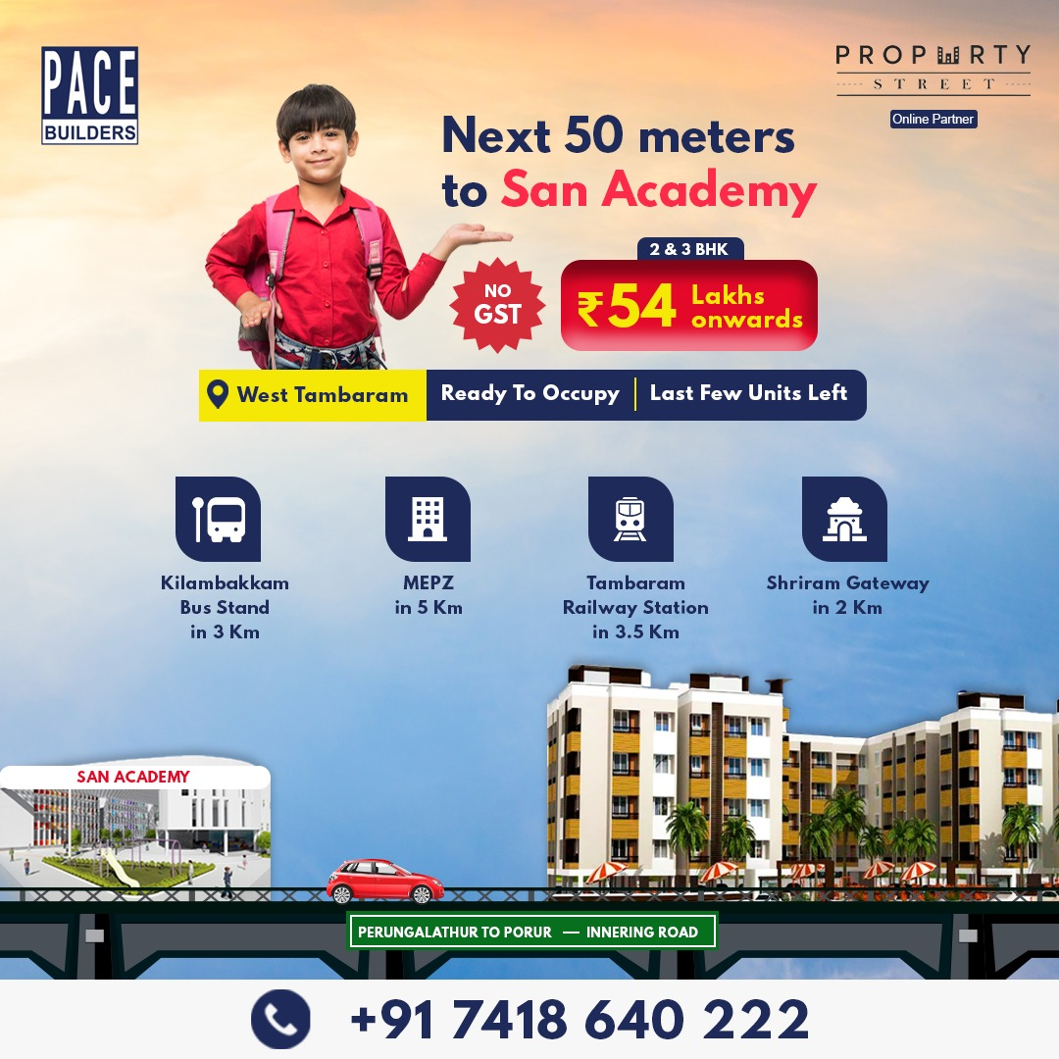

Slide 12



Slide 13



Slide 14



Slide 15



Slide 16



Slide 17



Slide 18



Slide 19
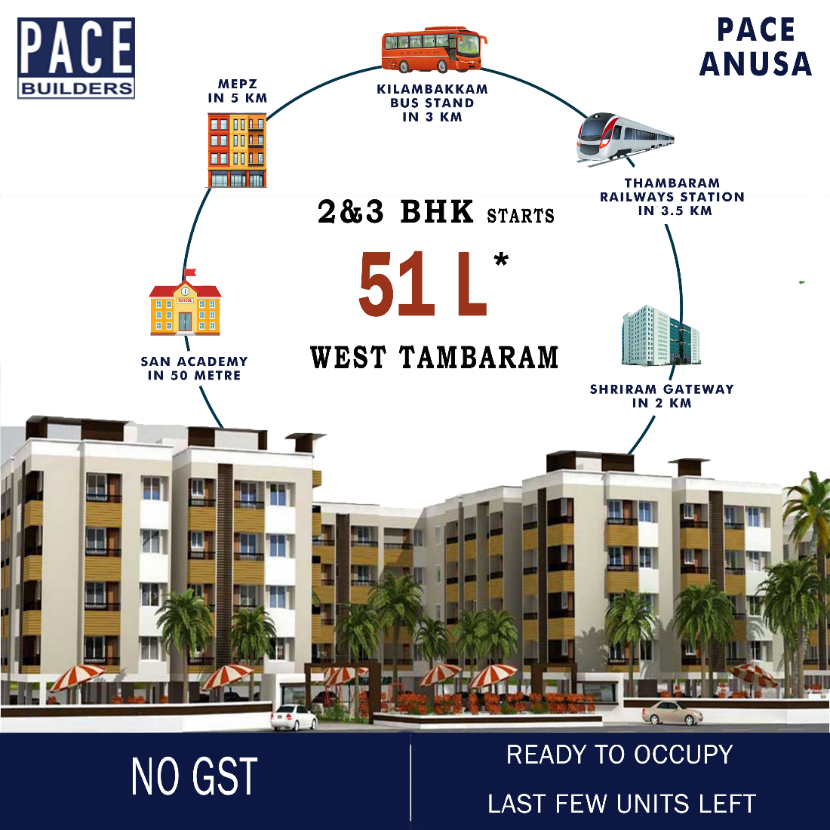


Slide 20



Slide 21



Slide 22



Slide 23



Slide 24



Slide 25



Slide 26



Slide 27



Slide 28



Slide 29



Slide 30



Slide 31








Logo
(Finalized)

Slide 32



Our Clients are
HAPPY
Working with us

Slide 33
THE BEST MARKETING
doesn’t feel like
marketing
Contact
Awfis, Primus Building, Door No. SP–7A, Guindy Industrial Estate, SIDCO Industrial Estate, Guindy, Chennai – 600032 www.greenbuds.co.in
support@greenbuds.co.in
Mobile/Whatsapp - +91 – 99422 10913

